Slide 1
Digital Electronics
Principles & Applications
Fifth Edition
Roger L. Tokheim
Chapter 5
IC Specifications
and Simple Interfacing
©1999 Glencoe/McGraw-Hill

Slide 2
CHAPTER 5 PREVIEW
Logic Levels/Noise Margin
Other Specifications
MOS and CMOS ICs
Interfacing with Switches
Interfacing with LEDs
Interfacing ICs
Interfacing with Buzzers, Relays, Motors and Solenoids
Optoisolators
Interfacing with Stepper Motors

Slide 3
LOGIC LEVELS / NOISE MARGIN
Voltage characteristic - defines logical 0 (LOW) or logical 1 (HIGH)
Noise immunity (noise margin)- logic circuit’s insensitivity or resistance to undesired voltages called “noise.”
TTL Voltage Profiles Chart
Input
Output
LOW
GND - 0.8V
GND - 0.4V (0.1V typical)
HIGH
2.0 - 5.5V
2.4 - 5.5V (3.5V typical)

Slide 4
INPUT VOLTAGE PROFILES- TTL AND 4000 SERIES CMOS
Input Voltage Profiles
TTL
CMOS
100%
+5V
90%
+10V
80%
HIGH
70%
HIGH
60%
50%
CAUTION
Output V profile differs
Other families V profile differs
LOW
0 to +3V for CMOS
0 to +0.8V in TTL
HIGH
+7V to +10V - CMOS
+2V to +5V - TTL
Undefined
+3 to +7V for CMOS
+0.8V to +2.0V for TTL
40%
Undefined
logic probe reading may
vary depending on
manufacturer
30%
20%
LOW
10%
LOW
GND
0%

Slide 5


TEST
TTL Voltage Profiles
INPUT
OUTPUT
H
+5V
+2V
+0.8V
GND
+5V
+2.4V
+0.4V
GND
H
Input = +0.3V
Output = ?
Input = +1.2V
Output = ?
Input = +4V
Output = ?
Input = +2.2V
Output = ?
Undefined
?
?
HIGH
LOW
HIGH
?
?
?
Low
Low
(Left mouse click for questions and answers)

Slide 6
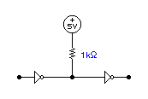
TTL-TO-CMOS INTERFACING
Interfacing is the design of circuitry between devices.
Interface circuitry shifts levels of voltage & current for compatibility.
TTL and CMOS HIGH and LOW voltage profiles are different.
Current requirements for TTL and CMOS are different.
Example:
Pull up resistor
Design Notes:
1. Output current of TTL OK to
drive CMOS device.
2. Output voltage profile does NOT
fit CMOS input voltage profile.
3. Use pull up resistor as interface
device to adjust voltage profiles.
Standard TTL
CMOS

Slide 7

CMOS-TO-TTL INTERFACING
Interfacing is the design of circuitry between devices.
Interface circuitry shifts levels of current & voltage for compatibility.
CMOS and TTL voltage profiles are different.
Current requirements for CMOS and TTL are different.
Example:
Design Notes:
1. Output voltage profile of CMOS
is OK to drive TTL inputs.
2. Output current from CMOS is
NOT enough to drive standard
TTL.
3. Use special purpose CMOS buffer
IC to adjust the current levels.
CMOS buffer
(like 4050 IC)
CMOS
Standard TTL

Slide 8
TEST
1. The design of circuitry to make TTL-to-CMOS or CMOS-to-TTL connections is called ___.
interfacing
2. TTL and CMOS voltage profiles are ___ (different, the same).
different
3. TTL and CMOS current input requirements and output drive capabilities are ___ (different, the same).
different
4. Interfacing standard TTL-to-CMOS involves using a(n) ___ (buffer, pull-up resistor) between the input TTL and CMOS devices.
pull-up resistor
(Left click mouse for questions and answers)

Slide 9
OTHER DIGITAL IC SPECIFICATIONS
Drive Capabilities- sometimes referred to as fan-in or fan-out.
Fan out- number of inputs of a logic family that can be driven by a single output. The drive capability of outputs.
Fan in- the load an input places on an output.
Propagation delay- has to do with the “speed” of the logic element. Lower propagation delays mean higher speed which is a desirable characteristic.
Power Dissipation- generally, as propagation delays decrease, power consumption and heat generation increase. CMOS is noted for low power consumption.

Slide 10
MOS AND CMOS ICs
MOS stands for metal-oxide semiconductor.
PMOS, NMOS, and CMOS are three technologies used to manufacture ICs. TTL is another very fast technology.
NMOS stands for negative-channel metal-oxide semiconductor. NMOS ICs are faster than PMOS.
PMOS stands for positive-channel metal-oxide semiconductor.
CMOS stands for complementary metal-oxide semiconductor. Both PMOS and NMOS devices are used it its manufacture.
CMOS ICs are noted for exceptionally low power consumption.
CMOS ICs were slower than bipolar digital ICs (such as TTL devices).
Transmission gates or bilateral switches are unique digital devices created using CMOS technology.

Slide 11
TEST
1. The drive capability of logic device outputs is sometimes called ___ (fan in, fan out). It is the number of inputs of a logic family that can be driven by a single output.
Fan Out
2. CMOS devices are noted for their extremely ___ (high, low) power consumption.
Low
3. A logic device with a low propagation delay would be considered to be a ___ (high, low) speed device.
High
4. Several desirable characteristics of logic devices are good drive capabilities, low power consumption, and ___ (high, low) propagation delays.
Low
(Left click mouse for questions and answers)

Slide 12
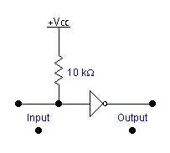
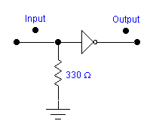
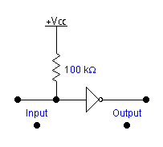
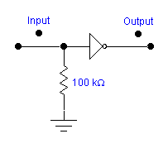
INTERFACING WITH SWITCHES
Switch-to-TTL interfaces
+5V
Pull up resistor
Pull up resistor
Pull up resistor
HIGH
LOW
HIGH
LOW
INPUT
pulled HIGH by
pull up resistor
INPUT
pulled LOW by
pull down resistor
INPUT
pulled HIGH by
pull up resistor
Pull down resistor
INPUT
pulled LOW by
pull down resistor
Pull down resistor
Pull down resistor
INPUT
pulled HIGH by
switch
INPUT
pulled LOW by
switch
INPUT
pulled HIGH by
switch
INPUT
pulled LOW by
switch
Switch-to-CMOS interfaces
With pull up resistor
With pull down resistor

Slide 13
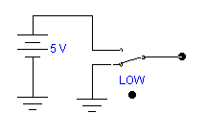
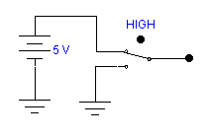
SWITCH DEBOUNCING
Mechanical switches that serve as inputs for some digital circuits (like counters) may need switch debouncing.
A Low-to-High switch transition can result in H-L-H bounces.
A demonstration of a debouncing circuit in action.
Notice
No switch bounce!
Debouncing
Latch
HIGH
LOW
time

Slide 14
TTL OR CMOS TO LEDs
+5 V
Either TTL or CMOS ICs can drive
an LED using a transistor.
150 Ω
HIGH
LOW
LOW
Transistor ON
HIGH
TTL or
CMOS
Off
33 kΩ
(Mouse click for action)

Slide 15
INTERFACING WITH BUZZERS, RELAYS, MOTORS & SOLENOIDS
Piezo buzzer - a signaling device drawing less current than older buzzers and bells.
DC or AC motors - produce continuous rotary motion. (Motor voltages and current not compatible with logic circuits.)
Solenoid - a device that can produce linear motion.
Relay - a device to isolate logic device from high-voltage/current circuit.
Optoisolator - a device to isolate logic device from high-voltage/current circuit.

Slide 16
ISOLATION- LOGIC TO HIGH VOLTAGE/CURRENT
Electromechanical relays - older method of isolation. Relays are expensive, heavy, and produce “noise.”
Optoisolator (optocoupler) - light weight alternative to electromagnetic relay when interfacing with logic circuits.
Solid state relay - a heavy-duty version of an optoisolator.

Slide 17
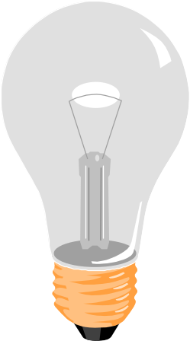
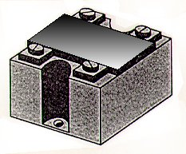
OPTICAL ISOLATION
120 VAC
Solid state relay
or optoisolator
5 VDC
Load ground
(Left click for L-to-H input signal)
Logic ground

Slide 18
STEPPER MOTOR OPERATION
Sequence Chart
Step L1 L1 L2 L2
1 1 0 1 0
2 0 1 1 0
3 0 1 0 1
4 1 0 0 1
1 1 0 1 0
2 0 1 1 0
L1
L1
L2
Note:
Use --> key for CW,
then <-- key for CCW rotation)
L2

